Slide 1

Prediction of Tariff Rate
PS Number - PU131
Organization – TCI ( Transport Corporation of India )
Team : TechKnot
Team Leader: Sahil Khandelwal
Members: Arka, Sonali, Tushar, Harsh and Akshat

Slide 2
Problem Statement
To predict the tariff rate for part truck load (Sundry and LTL).
Project Scope:
Ability to predict tariff rate for sundry based on historical data
Ability to incorporate external factors listed under factors heading
Ability to incorporate automated routing and notifications based on existing business rules
Deliverables:
The project is for TCI Freight division. This project is aimed to automate the generation of tariff rates for part truck load.

Slide 3
Approach
We will explore the problem in following stages:
Hypothesis Generation – understanding the problem better by brainstorming possible factors that can impact the outcome
Data Exploration – looking at categorical and continuous feature summaries and making inferences about the data.
Data Cleaning – imputing missing values in the data and checking for outliers
Feature Engineering – modifying existing variables and creating new ones for analysis
Model Building – making predictive models on the data

Slide 4
Hypothesis Generation
1. Seasonal Impact:
Climatic
Influences
Natural
Calamities
Festivals
2. Fuel Cost
3. Distance
4. Vehicle type/capacity
5. Toll charge
6. Labor cost
7. Demand
8. Customer loyalty
9. Government Regulations
10. Geopolitical events
11. Transit time
12. Nature of Product
13. Security
14. Insurance

Slide 5
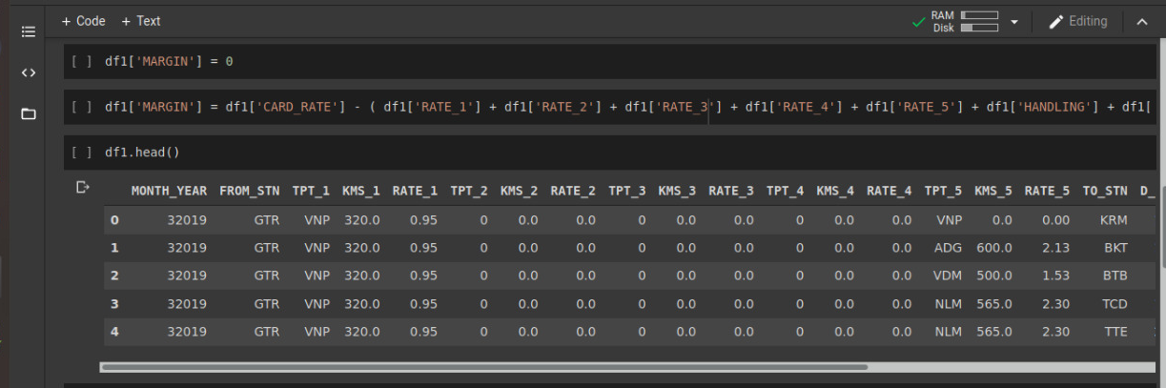
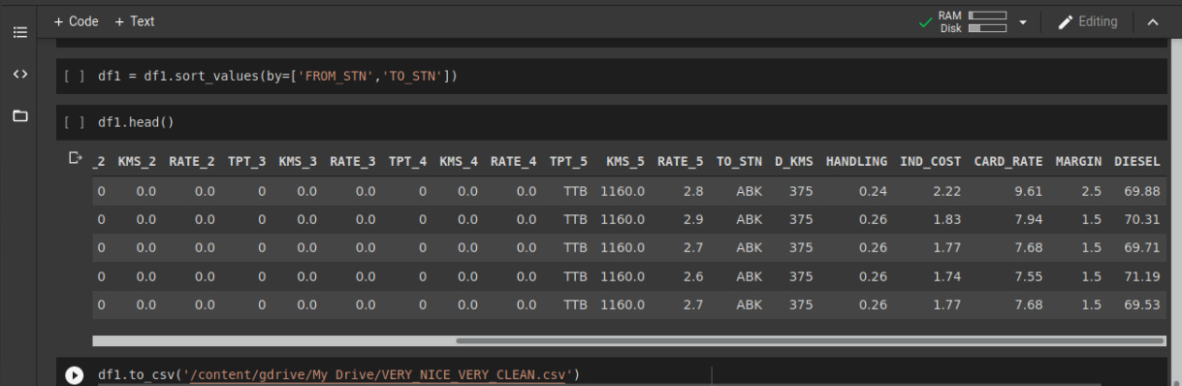
Data Exploration

Slide 6
Dependent Variables
Independent Variables
From Station
To Station
Date
Diesel Price
Event Factor
Handling Cost
Industrial Cost
Card Rate

Slide 7
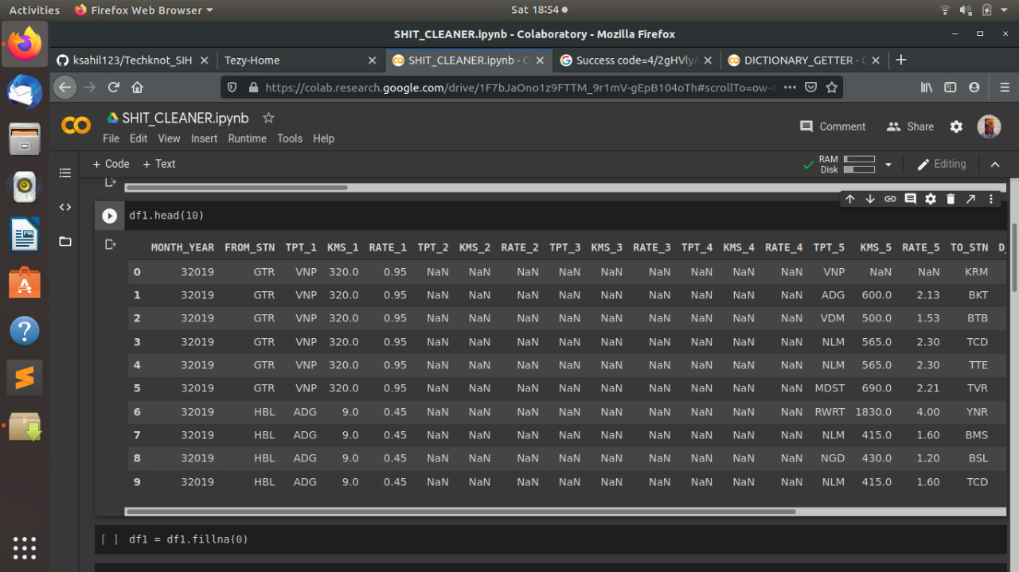
Data Cleaning

Slide 8
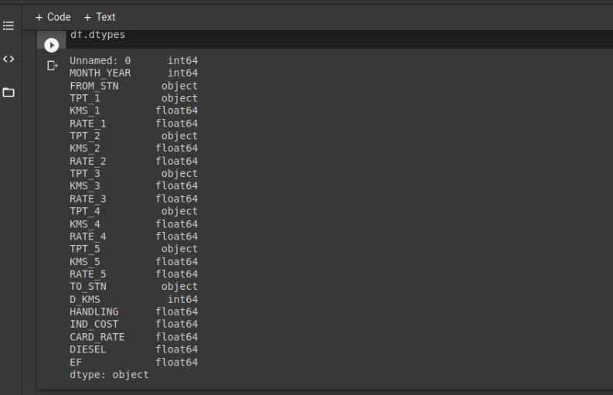
Feature Engineering

Slide 9
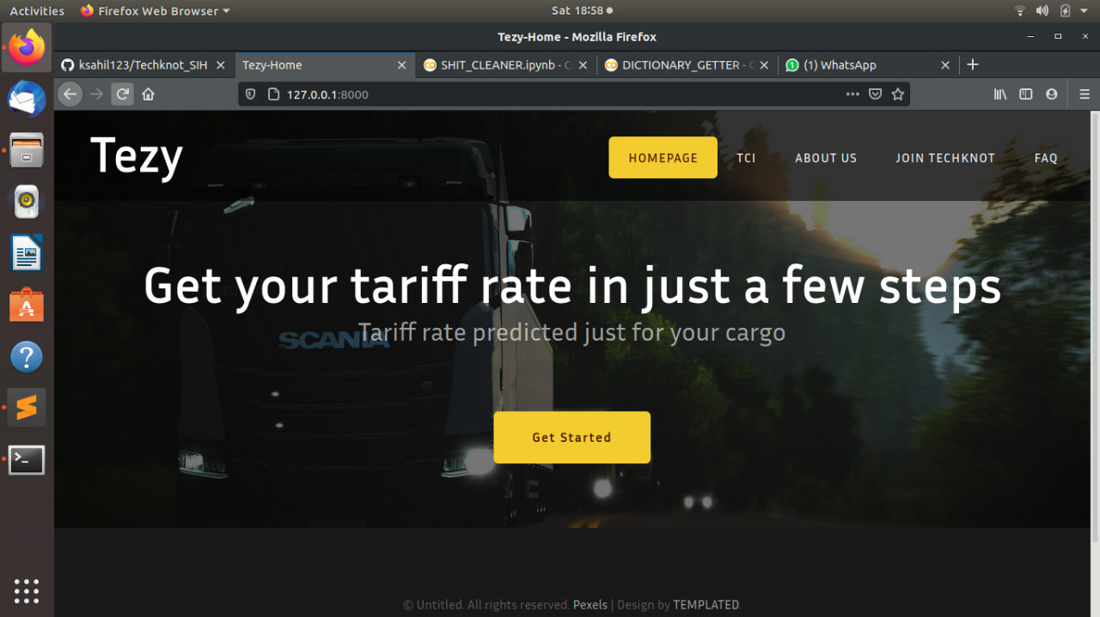
Website Portal

Slide 10
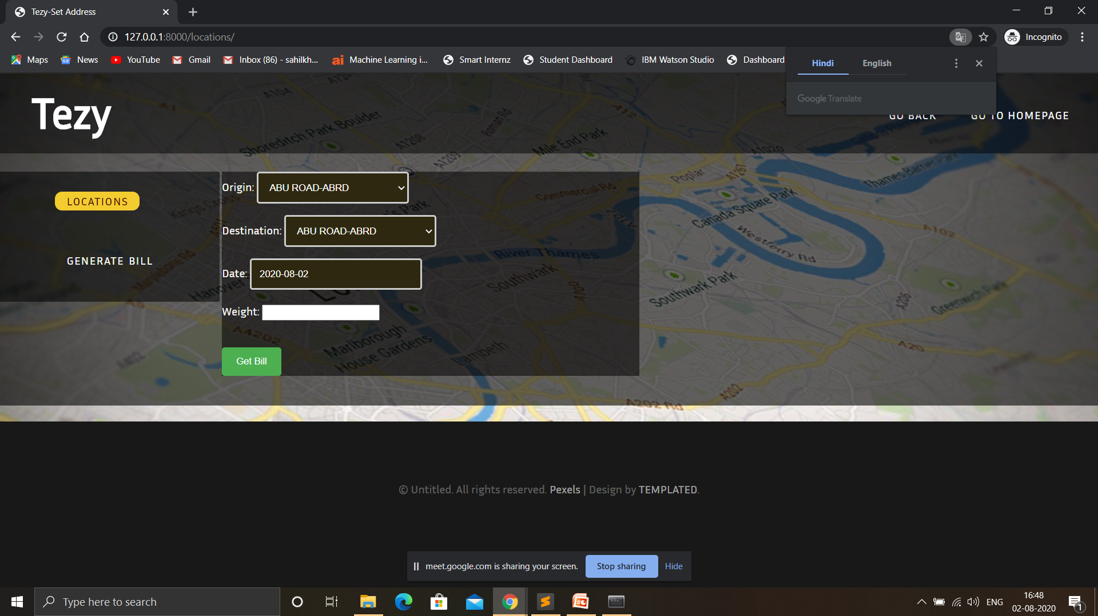
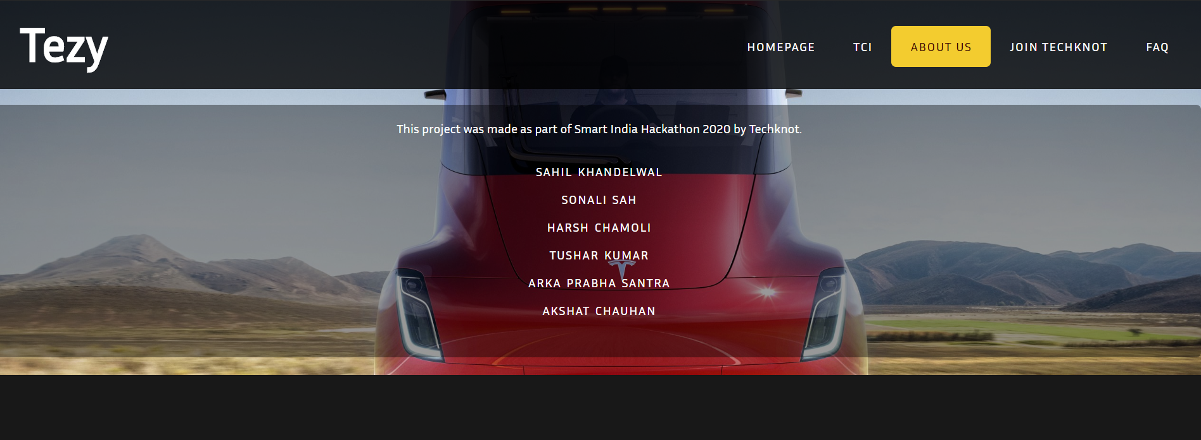

Slide 11
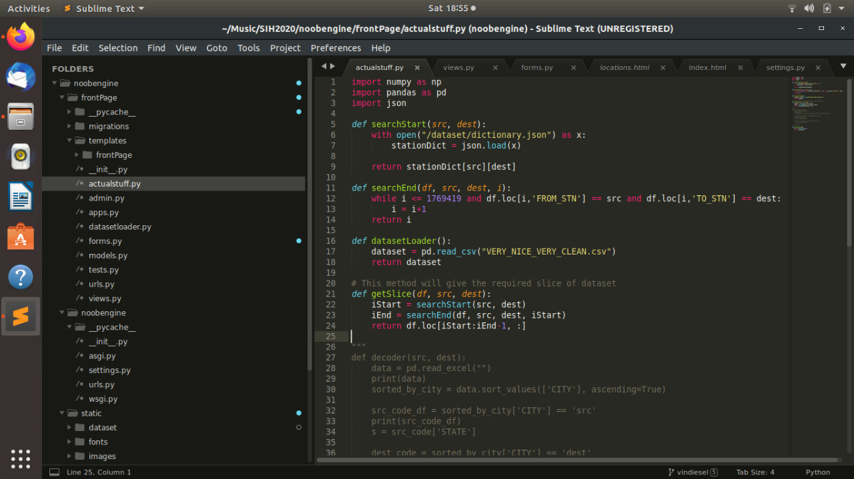
Some glimpse of code

Slide 12
Technology Stack
Programming Language | Python 3.x ( Conda Environment )
Editor | Google Colab, Sublime Text
Libraries / Packages | Numpy, Pandas, Scikit-learn
Framework | Django

Slide 13
QUESTIONS?

